Slide 1
Cloud: Openstack
Slides from Antonio Corradi & Luca Foschini
Univ. of Bologna, Italy
2014-2015

Slide 2
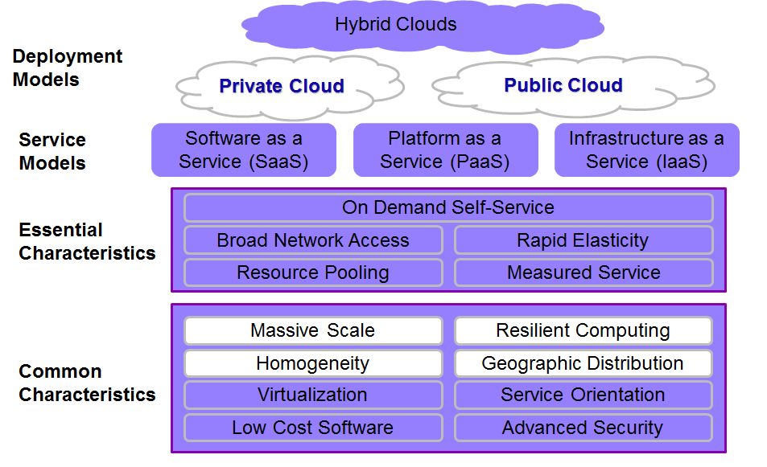
NIST STANDARD CLOUD
National Institute of Standards and Technology www.nist.gov/

Slide 3
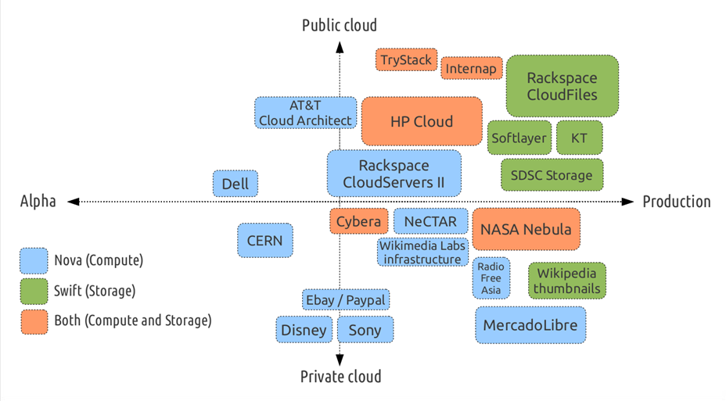
Known Deployment Models

Slide 4




Cloud: resource virtualization
First step: Server virtualization
HOST 1
HOST 2
HOST 3
HOST 4, ETC.
VMs
Hypervisor:
Turns 1 server into many “virtual machines” (instances or VMs)
(VMWare ESX, Citrix XEN Server, KVM, Etc.)
Hypervisors provide an abstraction layer between hardware and software
Hardware abstraction
Better resource utilization for every single server
Notes:
Nuova slide

Slide 5



Cloud: resource virtualization
Second step: network and storage virtualization
Compute Pool
Network Pool
Storage Pool
Virtualized Servers
Virtualized Networks
Virtualized Storage
Resource pool available for several applications
Flexibility and efficiency
Notes:
Nuova slide

Slide 6

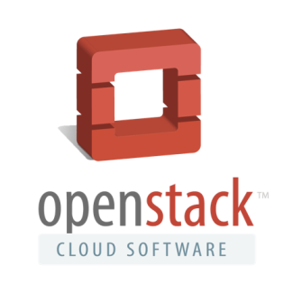
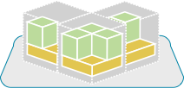
High-level Architecture of the OpenStack Cloud IaaS
APPS
Connects to apps
via APIs
USERS
ADMINS
CLOUD OPERATING SYSTEM
Creates Pools of Resources
Automates The Network

Slide 7
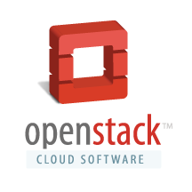
OpenStack history in a nutshell
OpenStack
Founded by NASA and Rackspace in 2010
Currently supported by more than 300 companies and 13866 people
Release slides based on: Juno, October 2014
Current release: Stein, April 2019
Six-month time-based release cycle (aligned with Ubuntu release cycle)
Open-source vs Amazon, Microsoft, Vmware…
Constantly growing project

Slide 8
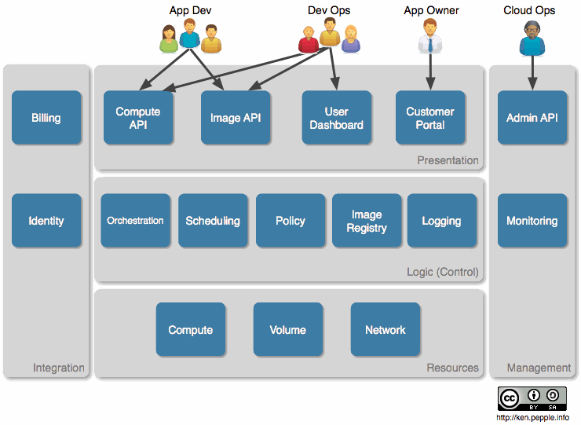
Main Functions in a Cloud

Slide 9
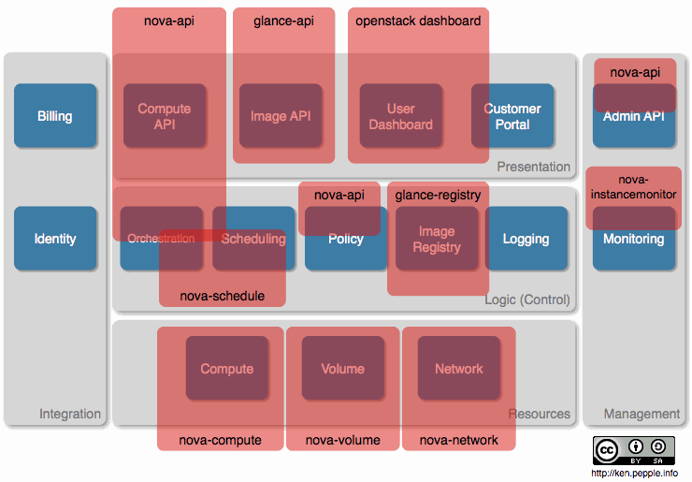
Main Functions in a Cloud
ceilometer
cinder-volume
neutron

Slide 10
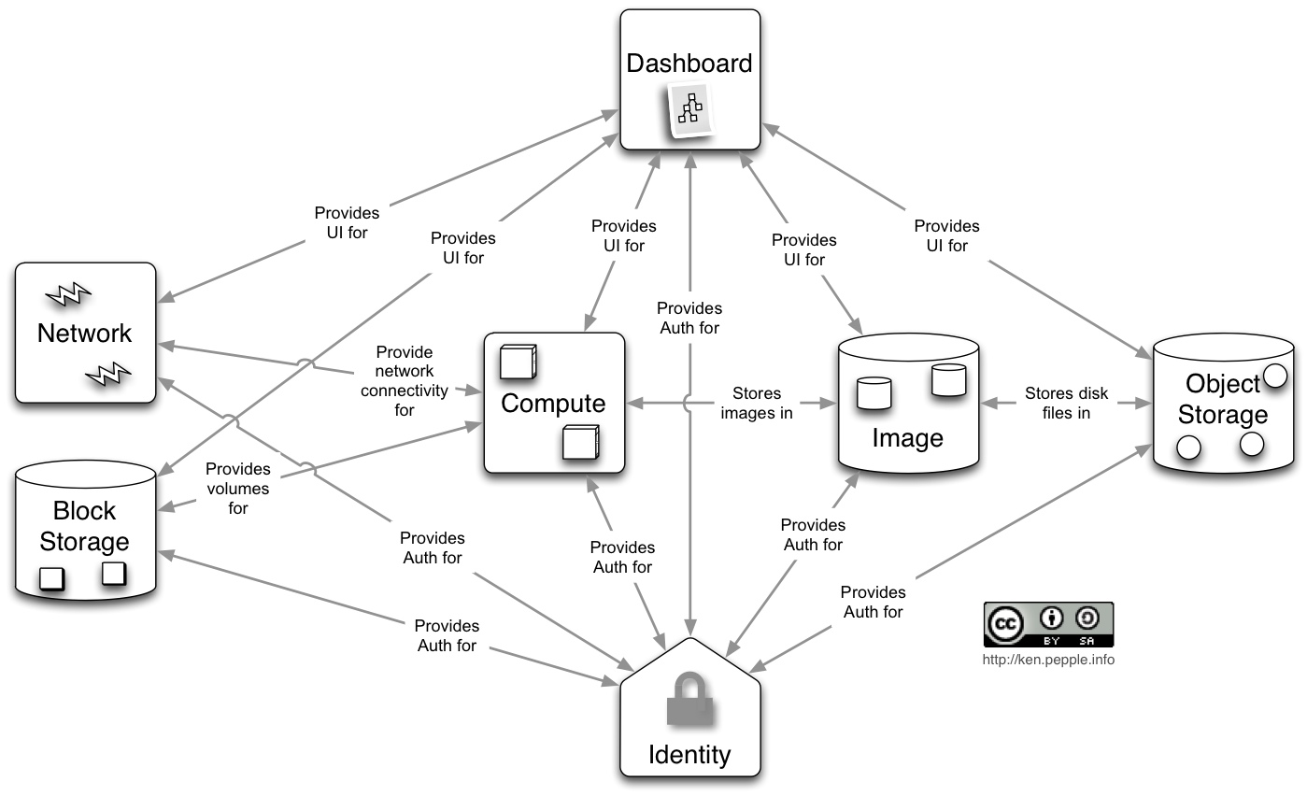
OpenStack main services

Slide 11
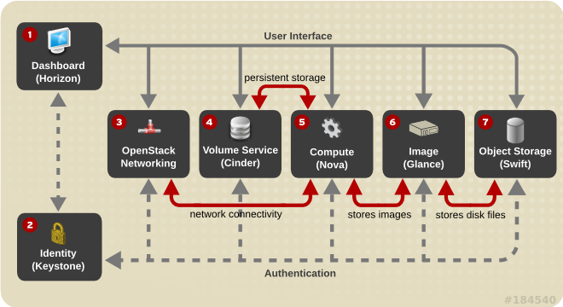
OpenStack main services

Slide 12
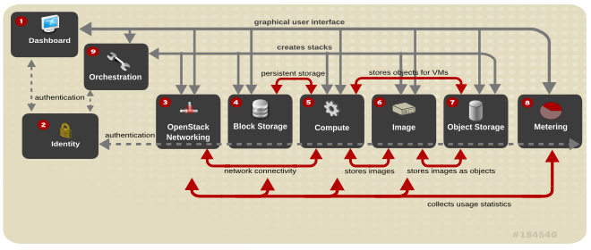
OpenStack main services

Slide 13
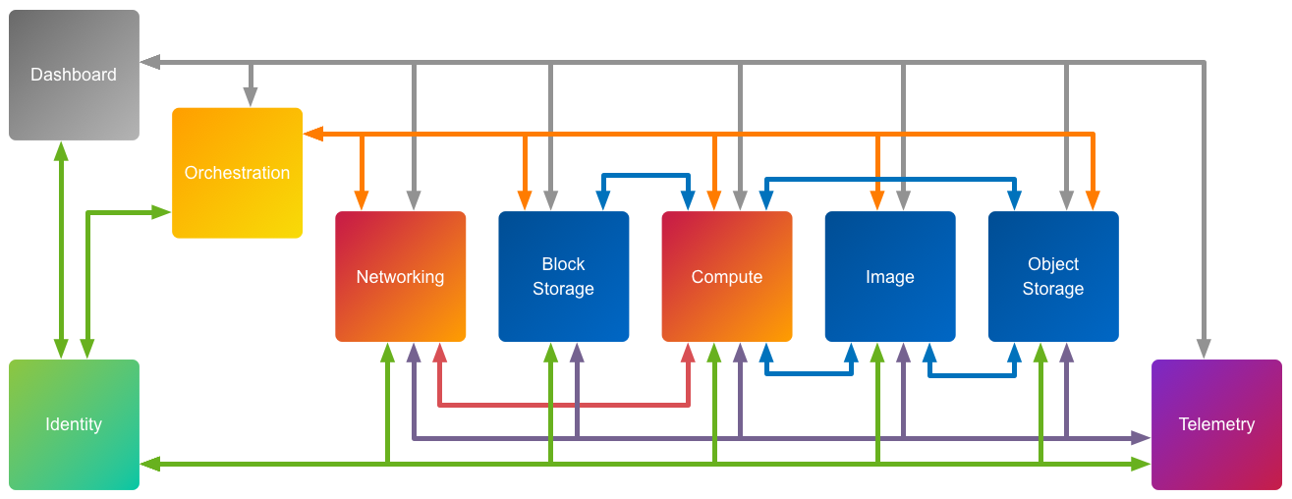
OpenStack services
Heat
Ceilometer
Heat: main project of OpenStack orchestration.
Allows users to describe deployments of cloud applications in templates.
Templates parsed & executed by Heat engine.

Slide 14
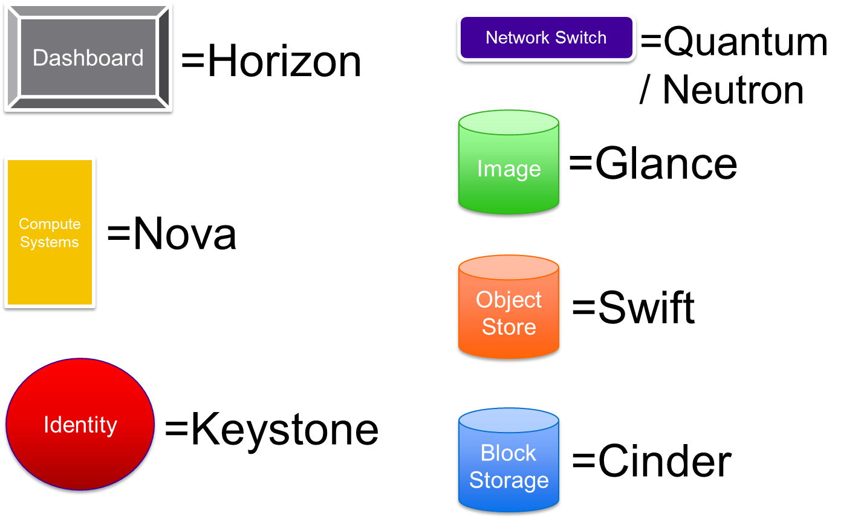
OpenStack main components
Ceilometer Heat

Slide 15
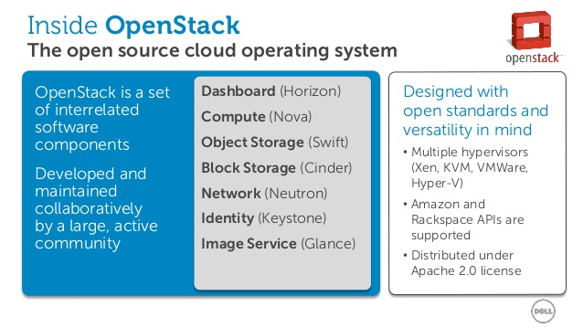
OpenStack main components

Slide 16
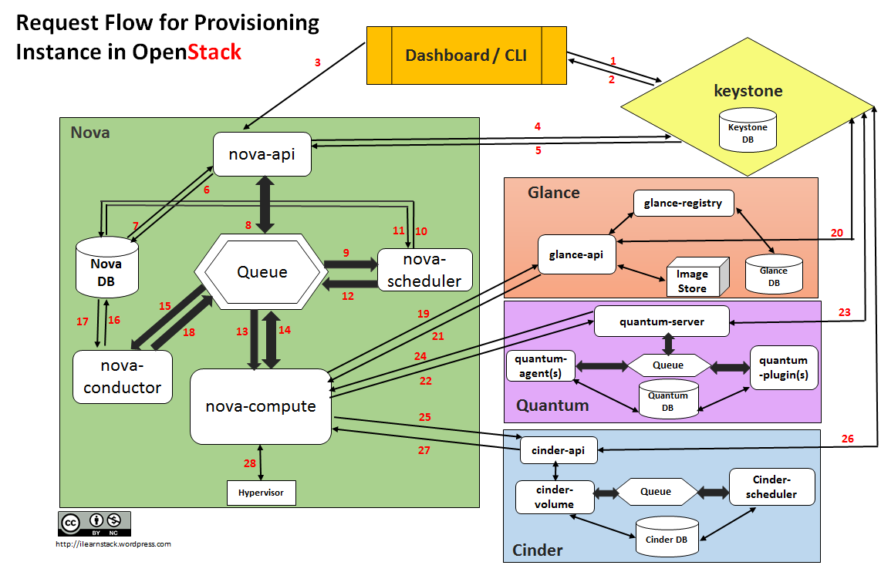
OpenStack main worflow
cloud networking
controller: Neutron

Slide 17
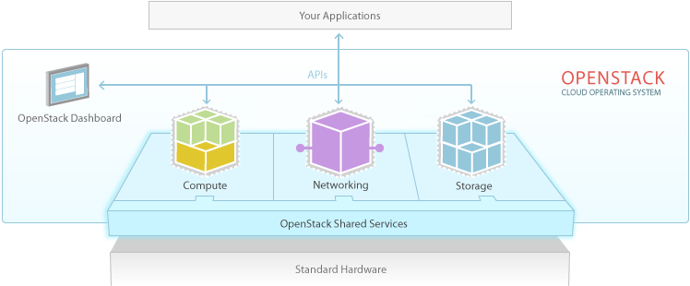
OpenStack services (detailed)
Identity Service
Image Service
Dashboard: Web application used by administrators and users to manage cloud resources
Identity: provides unified authentication across the whole system
Object Storage: redundant and highly scalable object storage platform
Image Service: component to save, recover, discover, register and deliver VM images
Compute: component to provision and manage large sets of VMs
Networking: component to manage networks in a pluggable, scalable, and API-driven fashion

Slide 18
OpenStack Services: Design Guidelines
All OpenStack services share the same internal architecture organization that follow a few clear design and implementation guidelines:
Scalability and elasticity: gained mainly through horizontal scalability
Reliability: minimal dependencies between different services and replication of core components
Shared nothing between different services: each service stores all needed information internally
Loosely coupled asynchronous interactions: internally, completely decoupled pub/sub communications between core components/services are preferred, even to realize high-level synch RPC-like operations

Slide 19
OpenStack Services: Main Components
Deriving from the guidelines, every service consists of the following core components:
pub/sub messaging service: Advanced Message Queuing Protocol (AMQP) standard and RabbitMQ default implementation
an API component: acting as a service front-end to export service functionalities via interoperable RESTful APIs
one/more internal core components: realizing the service application logic
a local database component: storing internal service state adopting existing solutions, and making different technological choices depending on service requirements (ranging from MySQL to highly scalable MongoDB, SQLAlchemy, and HBase)

Slide 20
Nova - Compute
Provides on-demand virtual servers
Provides and manages large networks of virtual machines (functionality moved to Neutron)
Modular architecture designed to horizontally scale on standard hardware
Supports several hypervisors (i.e. KVM, XenServer,VMWare, etc.)
Developers can access computational resources through APIs
Administrators and users can access computational resources through Web interfaces or CLI

Slide 21
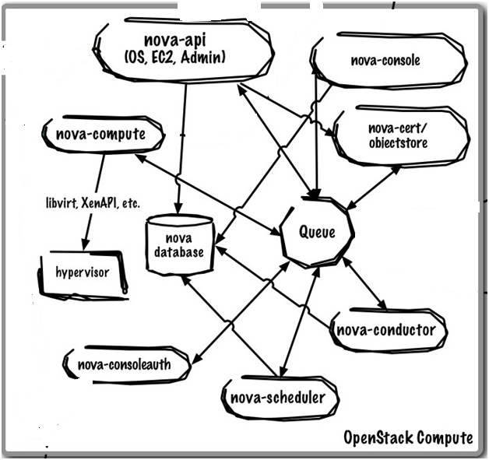
Nova – Components (a good OpenStack service example)
libvirt is an open-source API from RedHat: it is a daemon and management tool for managing
platform virtualization (manage KVM, Xen, VMware ESXi, QEMU and other virtualization techs.)
Used in the orchestration layer of hypervisors for cloud-based solutions

Slide 22
Nova – Components (1)
nova-API: RESTful API web service used to send commands to interact with OpenStack. It is also possible to use CLI clients to make OpenStack API calls
nova-compute: hosts and manages VM instances by communicating with the underlying hypervisor
nova-scheduler: coordinates all services and determines placement of new requested resources
nova database: stores build-time and run-time states of Cloud infrastructure
queue: handles interactions between other Nova services. By default, it is implemented by RabbitMQ, but also Qpid can be used

Slide 23
Nova – Components (2)
nova-console, nova-novncproxy, nova-consoleauth: provides, through a proxy, user access to the consoles of virtual instances
nova-novncproxy - server daemon serving Nova noVNC Websocket Proxy service, compatible w/Nova noVNC consoles.
nova-network: accepts requests coming from the queue and executes tasks to configure networks (i.e., changing IPtables rules, creating bridging interfaces, …) These functionalities are now part of Neutron service.
nova-volume: handles persistent volumes creation and their de/attachment from/to virtual instances These functionalities are now part of Cinder services
nova conductor provides coordination and database query support for Nova.

Slide 24
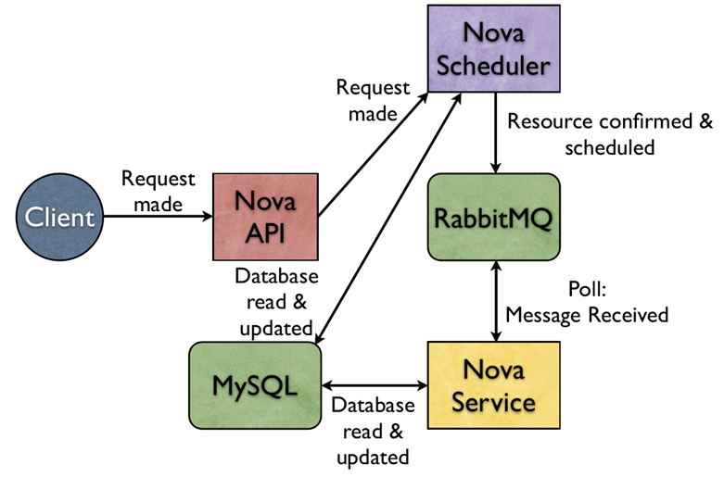
Nova General interaction scheme

Slide 25
Swift – Object Storage
Swift allows to store and recover files
Provides a completely distributed storage platform that can be accessed by APIs and integrated inside applications or used to store and backup data
It is not a traditional filesystem, but rather a distributed storage system for static data such as virtual machine images, photo storage, email storage, backups and archives
It doesn’t have a central point of control, thus providing properties like scalability, redundancy, and durability

Slide 26
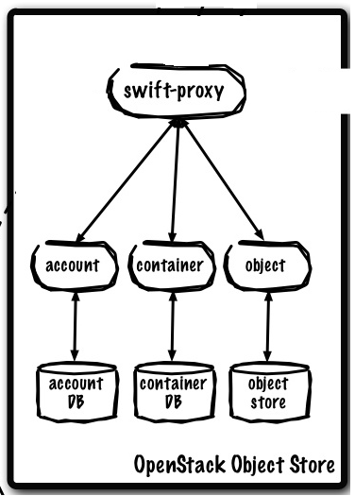
Swift - Components
Proxy Server: handles incoming requests such as files to upload, modifications to metadata or container creation
Accounts server: manages accounts defined through the object storage service
Container server: maps containers inside the object storage service
Object server: manages files that are stored on various storage nodes

Slide 27
Cinder – Block Storage
Cinder handles storage devices that can be attached to VM instances
Handles the creation, attachment and detachment of volumes to/from instances
Supports iSCSI, NFS, Fibre Channel, Replicated Block Device (RBD), GlusterFS (cluster file storage) protocols
Supports several storage platforms like Ceph, NetApp, Nexenta, SolidFire, and Zadara
Allows to create snapshots to backup data stored in volumes. Snapshots can be restored or used to create a new volume

Slide 28
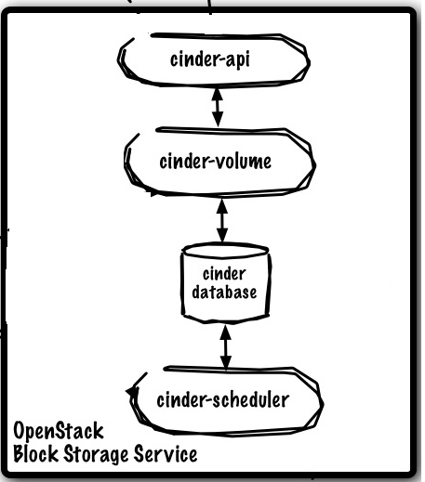
Cinder – Block Storage
cinder-API: accepts user requests and redirects them to cinder-volume in order to be processed
cinder-volume: handles requests by reading/writing from/to cinder database, in order to maintain the system in a consistent state Interacts with the other components through a message queue
cinder-scheduler: selects the best storage device where to create the volume
cinder database: maintains volumes’ state

Slide 29
Glance – Image Service
Glance handles the discovery, registration, and delivery of disk and virtual server images
Allows to store images on different storage systems, i.e., Swift
Supports several disk formats (i.e. Raw, qcow2, VMDK, etc.)

Slide 30
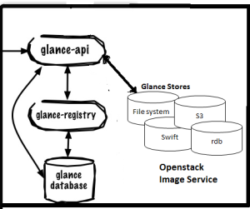
Glance – Components
glance-API: handles API requests to discover, store and deliver images
glance-registry: stores, processes and retrieves image metadata (dimension, format,...).
glance database: database containing image metadata
Glance uses an external repository to store images Currently supported repositories include filesystems, Swift, Amazon S3, and HTTP

Slide 31
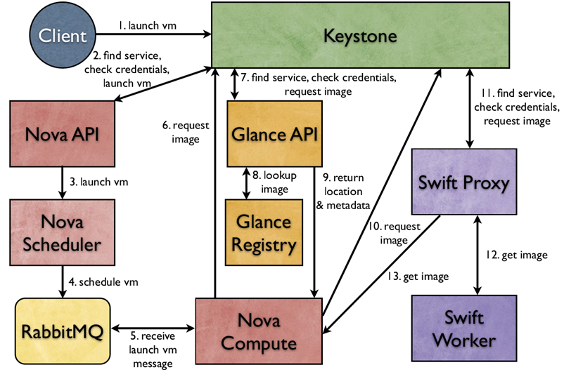
Nova – Launching a VM
OpenStack service provides API client authentication, service discovery & distributed multi-tenant authorization by implementing Identity API.

Slide 32
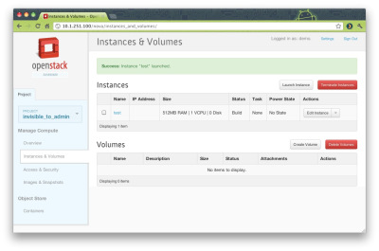
Horizon - Dashboard
Provides a modular web-based user interface to access other OpenStack services
Through the dashboard it is possible to perform actions like launch an instance, to assign IP addresses, to upload VM images, to define access and security policies, etc.

Slide 33
Keystone – Authentication and Authorization
Keystone is a framework for the authentication and authorization for all the other OpenStack services
Creates users and groups (also called tenants), adds/removes users to/from groups, and defines permissions for cloud resources using role-based access control features. Permissions include the possibility to launch or terminate instances
Provides 4 primary services:
Identity: user information authentication
Token: after logged-in, replaces password authentication
Catalog: maintains an endpoint registry used to discover OpenStack services endpoints
Policy: provides a rule-based authorization engine

Slide 34
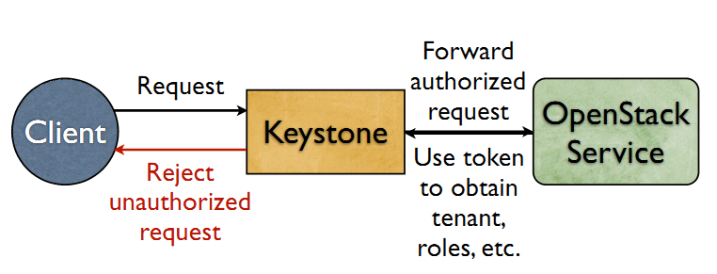
Keystone

Slide 35
Neutron Networking
Pluggable, scalable API-driven support to manage networks and IP addresses.
NaaS “Network as a Service” Users can create their own networks and plug virtual network interface into them
Multi-tenancy: isolation, abstraction and full control over virtual networks
Technology-agnostic: APIs specify service, while vendor provides his own implementation. Extensions for vendor-specific features
Loose coupling: standalone service, not exclusive to OpenStack

Slide 36
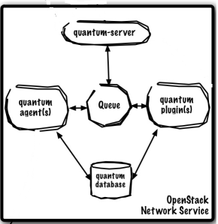
Neutron – Components
neutron-server: accept request sent through APIs and forwards them to the specific plugin
Plugins and Agents: executes real actions, such as dis/connecting ports, creating networks and subnets, creating routers, etc.
message queue: delivers messages between neutron-server and various agents
neutron database: maintains network state for some plugins

Slide 37
Neutron – Agents
dhcp agent: provides DHCP functionalities to virtual networks
plugin agent: runs on each hypervisor to perform local vSwitch configuration. The agent that runs, depends on the plug-in used (e.g., OpenVSwitch, Cisco, Brocade, etc.).
L3 agent: provides L3/NAT forwarding to provide external network access for VMs

Slide 38
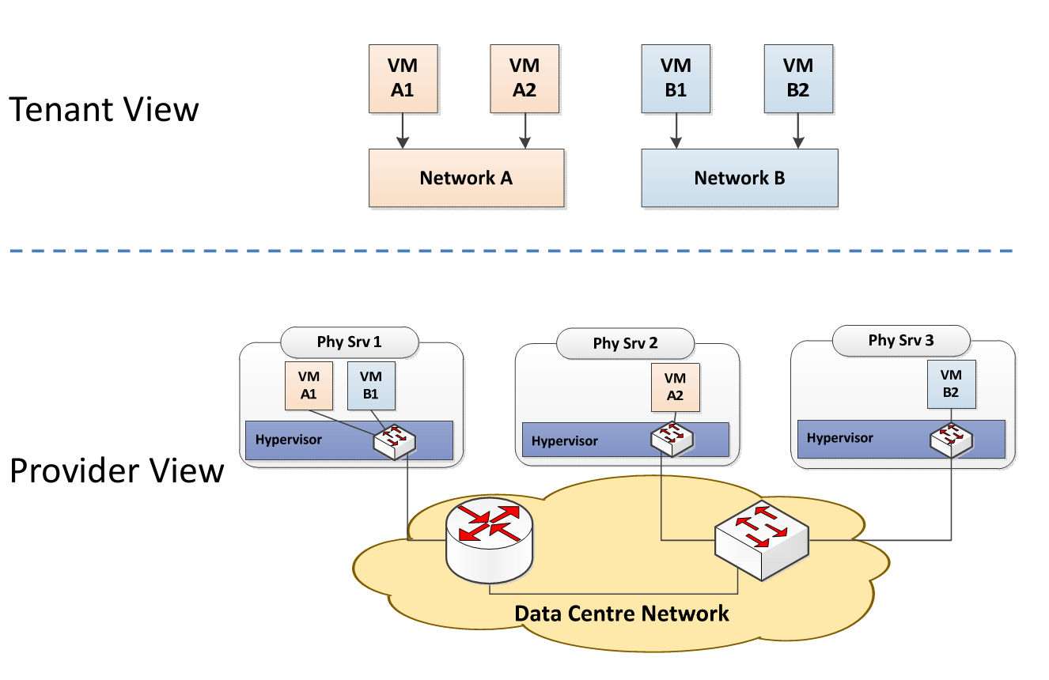
Neutron logical view vs. physical view
Neutron decouples the logical view of the network from the physical view
It provides APIs to define, manage and connect virtual networks

Slide 39
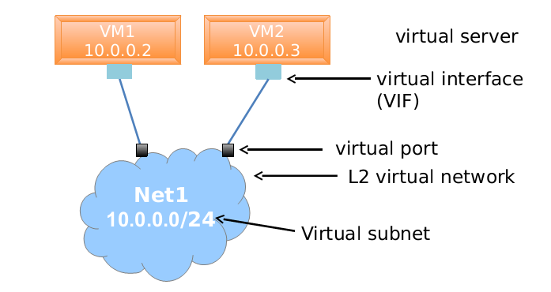
Neutron - logical view
Network: represents isolated virtual Layer-2 domains; a network can also be regarded as a logical switch;
Subnet: represents IPv4 or IPv6 address blocks that can be assigned to VMs or router on a given network;
Ports: represent logical switch ports on a given network that can be attached to the interfaces of VMs. A logical port also defines the MAC address and the IP addresses to be assigned to the interfaces plugged into them. When IP addresses are associated to a port, this also implies the port is associated with a subnet, as the IP address was taken from the allocation pool for a specific subnet.

Slide 40
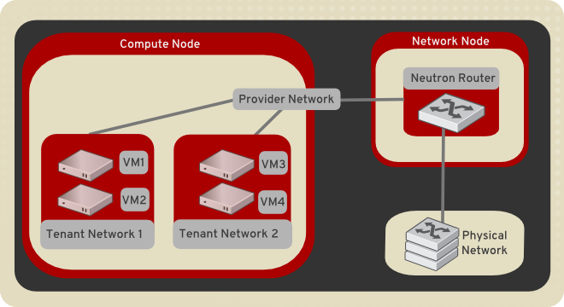
Neutron - tenant networks
Tenant networks can be created by users to provide connectivity within tenants. Each tenant network is fully isolated and not shared with other tenants.
Neutron supports different types of tenant networks:
Flat: no tenant support. Every instance resides on the same network, which can also be shared with the hosts. No VLAN tagging or other network segregation takes place;
Local: instances reside on the local compute host and are effectively isolated from any external networks;
VLAN: each tenant network uses VLAN IDs (802.1Q tagged) corresponding to VLANs present in the physical network. This allows instances to communicate with each other across the environment, (other than?) with dedicated servers, firewalls, load balancers and other networking infrastructure on the same layer 2 VLAN. Switch must support 802.1Q standard in order to provide connectivity between two VMs on different hosts;
VXLAN and GRE: tenant networks use network overlays to support private communication between instances. A Networking router is required to enable traffic to traverse outside of the tenant network. A router is also required to connect directly-connected tenant networks with external networks, including the Internet.

Slide 41
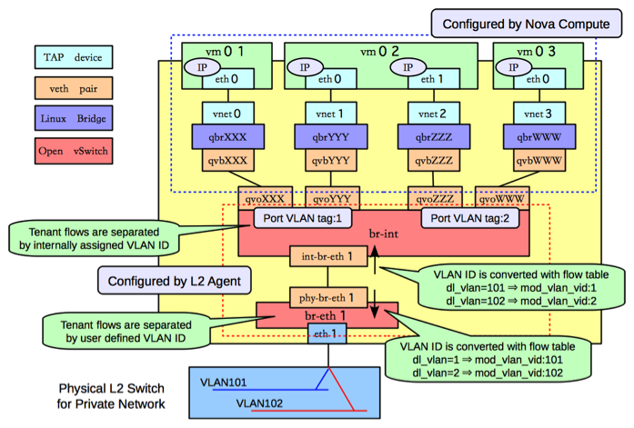
Neutron – VLAN tenant network

Slide 42
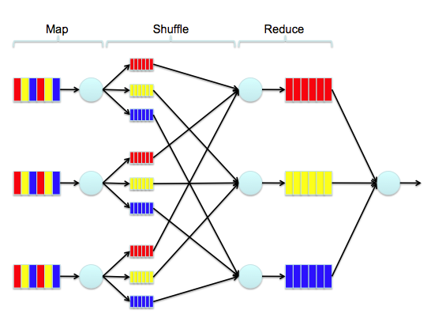

Apache Hadoop
Open source project for the development of distributed and concurrent applications
based on Google MapReduce
designed for distributed processing of large data sets across very large clusters of computers
highly fault tolerant
relies on Hadoop Distributed File System (HDFS) for the distribution of data

Slide 43
Hadoop for OpenStack
Hadoop can exploit the virtualization provided by OpenStack in order to obtain more flexible clusters and a better resource utilization
OpenStack service Sahara can be used to deploy and configure Hadoop clusters in a Cloud environment:
cluster scaling functionalities
Analytics as a Service (AaaS) functionalities
accessible via OpenStack dashboard, CLI or RESTful API

Slide 44
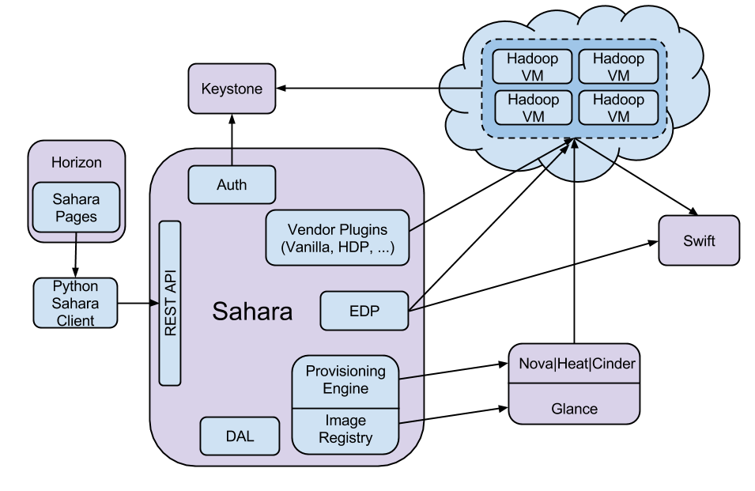
Sahara components

Slide 45
Cloud-based Context Data Handling
A smart city features thousands of sensors
State-of-the-art mobile devices are equipped with several onboard sensors, e.g., camera, accelerometers, GPS, etc.
Physical environments will include additional sensors, e.g., temperature and lighting sensors, feeding new data directly into the system
Cloud technologies enable the rapid provisioning of scalable services through distributed and virtualized resources
On-demand computing resources and pay-per-use model
Dynamic resource scaling depending on user requests
Cloud solutions for CDDI
High scalability to address context data storage and processing
Dynamic resource scaling lets the CDDI require new computing resources when the data to be processed increase (due to conference events, etc.)
Cloud solutions need VM placement algorithms to decide which VMs should be co-located on the same physical host

Slide 46


Network-aware VM Placement
Modern Data Centers (DCs) for Cloud computing
large-scale scale systems with hundreds of servers and thousands of Virtual Machines (VMs)
virtualization solutions to improve resource utilization by VM consolidation
VM placement must consider network requirements and constraints
useful to prevent reduced network performance
hard to enforce at run-time due to time-varying traffic demands
difficult to apply due to many entangled aspects, including network architecture, competing traffic demands, and so forth
TREE
FAT-TREE
VL2

Slide 47
Network-aware VM Placement
Virtualized DC
Co-location choices greatly affect the final traffic in the DC network
In-memory message passing mechanisms much faster than real network communications
Network fabric of modern DC employs graph-based topology and dynamic multi-path routing
No knowledge of which traffic flows will be routed on a specific link
Limited networking resources have to be considered to avoid unfeasible solutions
Network-aware VM placement addressed in the past with different objectives, but
Traffic demands are time-varying and traffic bursts can mine network performance
Placement stability has to be increased by ensuring spare capacities

Slide 48
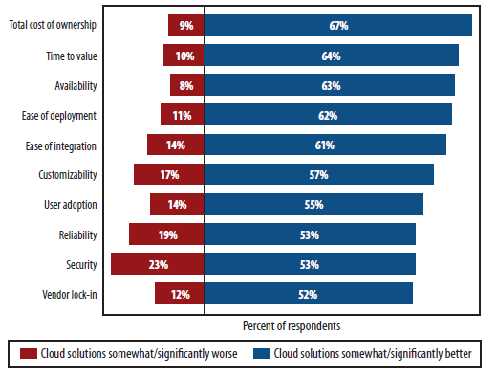
Cloud computing: reality check

Slide 49
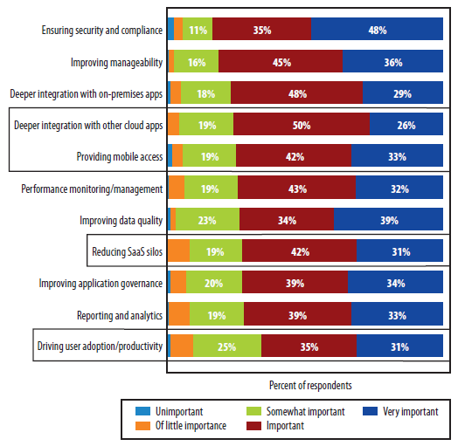
Cloud emerging challenges
Integration

Slide 50
Conclusions and open problems
Conclusions
Cloud computing is a new computational paradigm that we are already dealing with and we have to deal with
Cloud computing is a new emerging distributed architectural model
It doesn’t exist a common definition
but it is well described from the technological point of view (stack and main components)
Challenges
Cloud computing and economic model
“It is worth to rent external Cloud resources or to buy a private Cloud infrastructure?” → It depends, there are a lot of works dealing with this question
Security and data outsourcing → need of new trust models
Integration between Cloud and SaaS services
Notes:
Spostare alla fine o cambiare titolo?

Slide 51
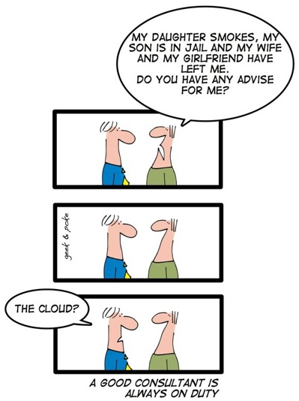
Cloud for everything
Not exactly for
everything ☺

Slide 52
Bibliography
Creeger M.
Cloud Computing: An Overview
ACM Queue, vol. 7, no. 5, pp. 3-4 (2009)
Lenk, A., Klems, M., Nimis, J. et al.
What's inside the Cloud? An architectural map of the Cloud landscape
In ICSE Workshop on Software Engineering Challenges of Cloud Computing (2009)
Vogels, W.
Eventually consistent
Communications of the ACM, vol. 52, no. 1, pp. 40-44 (2009)
Vogels, W.
Ahead in the Cloud - The Power of Infrastructure as a Service
http://blip.tv/file/981534 (2010)
Narasimhan, B.; Nichols, R.;
State of Cloud Applications and Platforms: The Cloud Adopters’ View IEEE Computer, vol. 44, no. 3, pp. 24-28 (Marzo 2011)

Slide 53
More documents …
OpenStack documentation
http://docs.openstack.org/
OpenStack Wiki
https://wiki.openstack.org/wiki/Main_Page
DevStack
http://devstack.org/
HOU J. T. C.; Liao W.
OpenStack Introduction
http://www.slideshare.net/jasonhoutw/openstack-introduction
(Giugno 2012)

